Slide 1
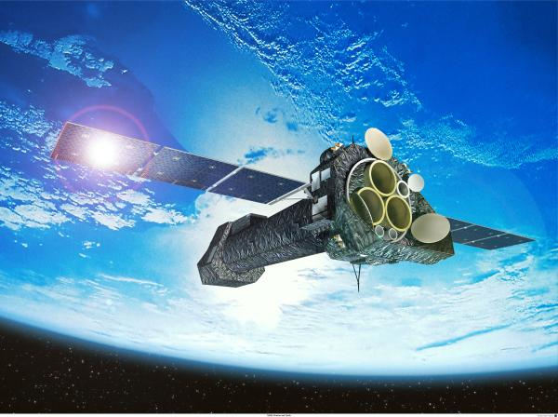
XMM-Newton Status
Jim Martin
XMM-Newton Spacecraft Operations Engineer
March 2018

Slide 2
menu
spacecraft status
  mission performance
  sub-system status, life limiting elements:
    power, fuel (migration), reaction wheels
  orbital evolution
  environmental
  AOCS wheel speed management
ground segment
  automation
  network & ground stations
  SPACON Merger

Slide 3
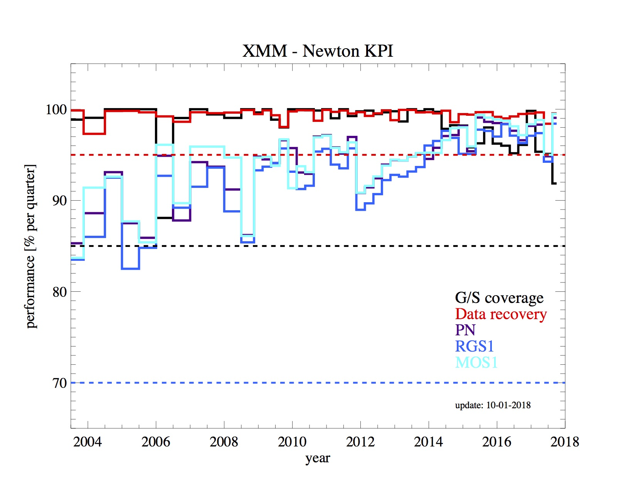
mission performance

Slide 4
spacecraft/mission status see: http://xmm.esoc.esa.int/information/sc_health.php
Money | Funded until next extension request 2018 | End 2018 in 2018→2019/20
Fuel | remaining Use per year Mileage | 44.5 Kg 3.0 kg/year 2030+
Thruster pulses | Remaining use per year Mileage | 17 000 (200000 qualified) <7 000 2020-2021 (B-system with full redundancy available, industry recommends to stay on A)
Solar array power | Maximum required Current margin | 1350 W 500 W
Battery | According to industry | 15+ y
Gyros/(IMUs) | Usage | < 29 %
Reaction wheels | Usage | < 51 %
Optocouplers | Mileage | ~ 2028
RF switches Transponder switches | Usage | Stuck at one position Back up not used instead transponders are switched TX A LCL switches <1500 TX B LCL switches <1500 (Qualified to 25000)

Slide 5
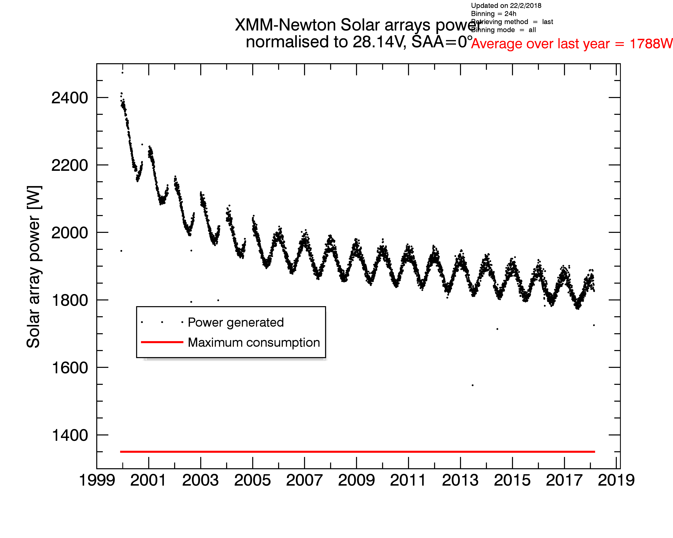
power

Slide 6
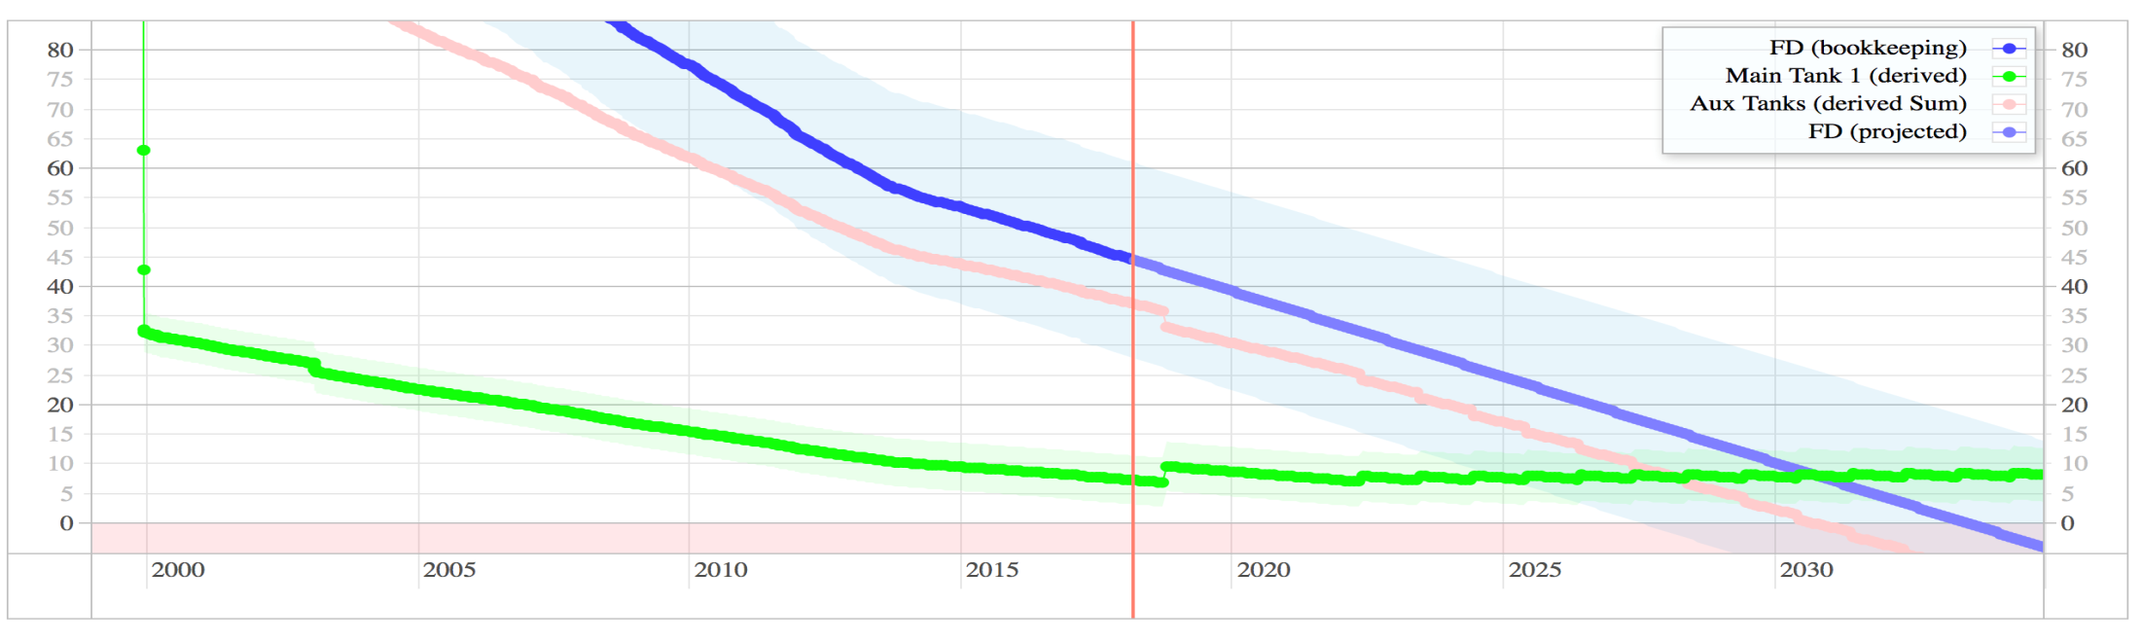
fuel (migration – status)
Switch of Migration setting (Tank1 cold, heating from A-side) performed in summer 2017
Full B-side ops will need some CDMU safety feature: needs to be in place before 2020, assuming current consumption
Replenishment activities will start as of 2022, assuming current consumption
Tank Feed Line
PMD
PMD
PMD
PMD
MT 1
AT 2
AT 3
AT 4
To RCS
Bubble Trap
PT

Slide 7
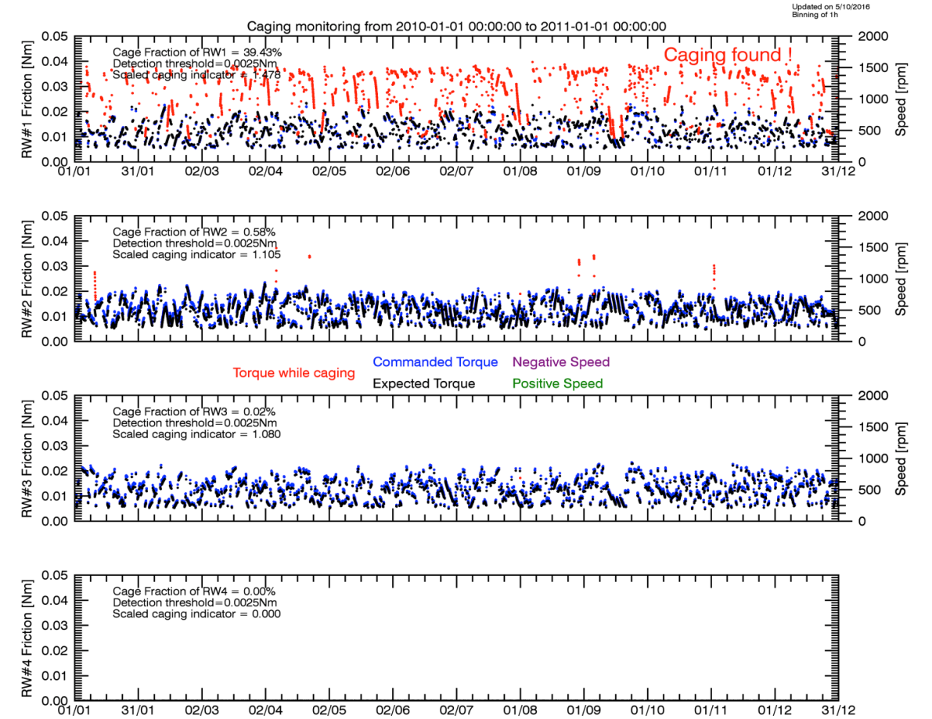
4WD side effects as a cure for reaction wheel cage instability
one respectively two of the XMM-Newton reaction wheels showed a non-nominal behaviour since 2008 (not flagged by the standard out-of-limits) and only discovered during the 4WD project
known phenomena with bearings running in marginally lubricated regimes
caused by too much or too little oil (late in the mission can only be due to reduction in oil quantity)
several space missions have suffered from degradation of their on-board momentum wheels.(Radarsat-1, NASA's Kepler, ESA's Rosetta …)

Slide 8
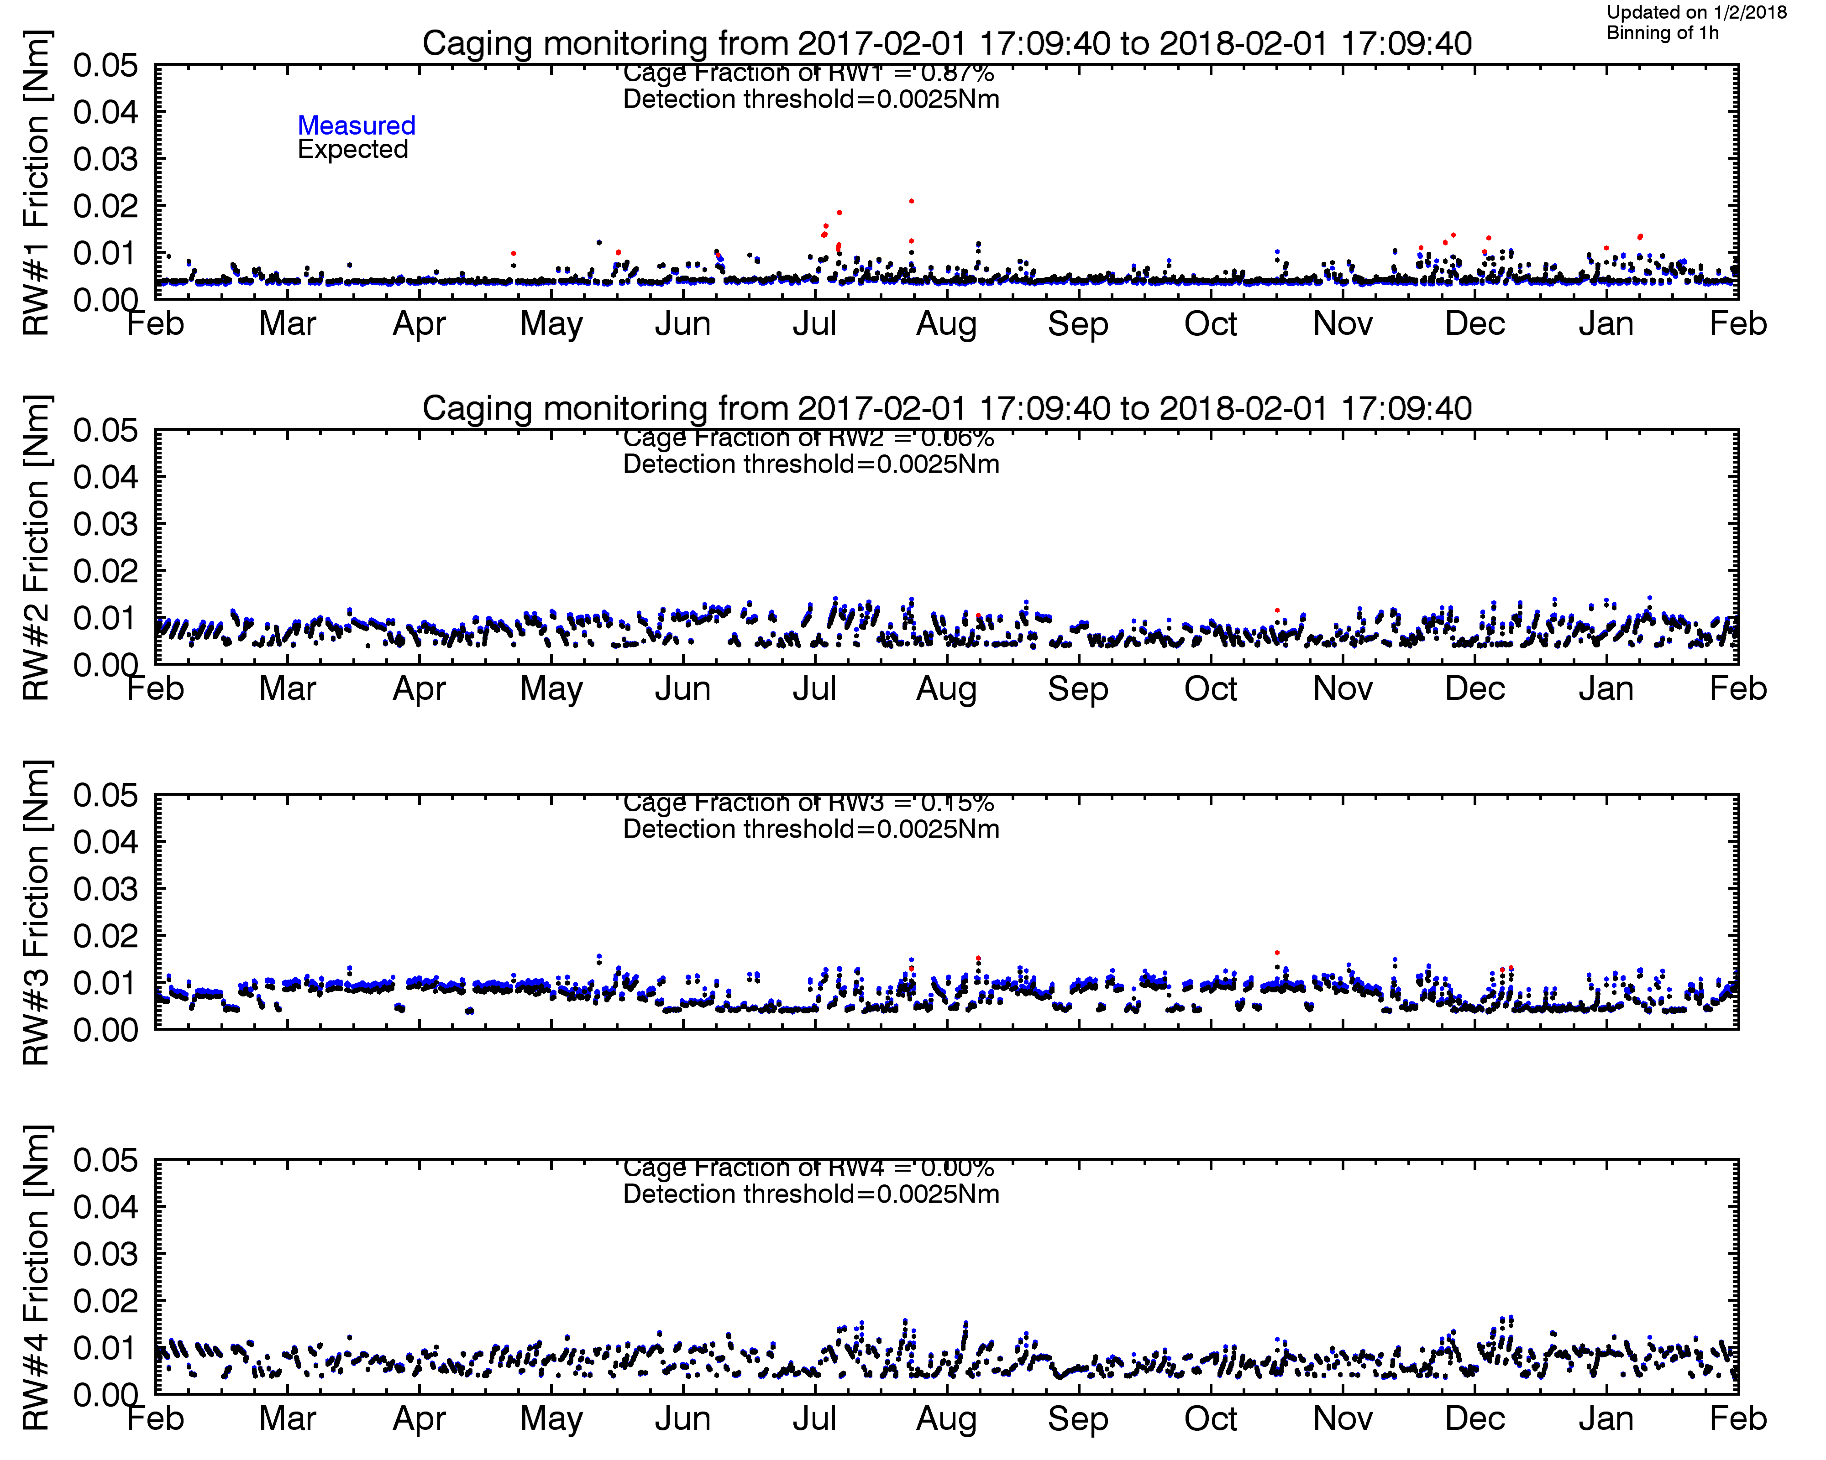
Caging status

Slide 9
orbit evolution
perigee decreased to about 5.197 km in early 2017
at the start of the routine phase mission in 2000, the perigee height was at 7.000 km
given the experience from INTEGRAL we do not expect issues regarding increased noise on the star tracker
collision potential with MEO and GEO objects is monitored by space debris office
(analysis by F/D and Debris office finished)
Minor orbit corrections needed to keep perigee gap (Kourou) where its best to be

Slide 10
AOCS improved wheel speed management
Reaction Wheel zero speed crossing to be allowed during revolution
→ reduce further potential wheel caging
  1st test successfully done 21/08/17
  Planning S/W in place since 31.08.2017
  Procedures ready for role out
  Test revolution 26.09.2017
  Planned to be active Q3 2018

Slide 11
MOC system evolution:
SIM migration status
Kick off December 12/15
PDR finished successfully in 03/16
Processor Emulator Acceptance completed Jan 2017
Final acceptance of full emulated February
Test procedures have been delivered for each sub-system to contractor
Preparation of validation process ongoing
Satellite H/W and environment delivered
ESOC validation to be completed mid April 2018
System Operational as of Q2/18
Warranty until Q1/19
See N. Pfeil et al.
SPACEOPS 2014 Pasadena

Slide 12
automation on ground - status
General status: system operational
Automated:
  SAS RESET
  RM crash
  CRP OM safety (closes OM in case of slew, or S/C movement if not closed)
  OM safety TT update
  Instrument safety TT checks and deletion
  Eclipse fully automated
  OM recovery
Under testing:
  G/S automation: handling of links for AOS/LOS/handover for G/S and antennae
  (expected to be operational end 2018)
  Downlink event and monitoring tables (pending implementation of G/S outage reaction)
  Slew and RWB validity checker (pending memory issue in MOIS)
Planned to automate:
  G/S outage reaction
  Instrument re-join (good interactions with the SOC)
  Concurrent procedure execution management
  MCS server swap

Slide 13
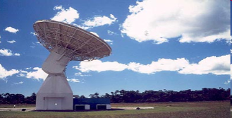
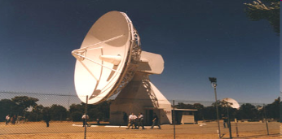
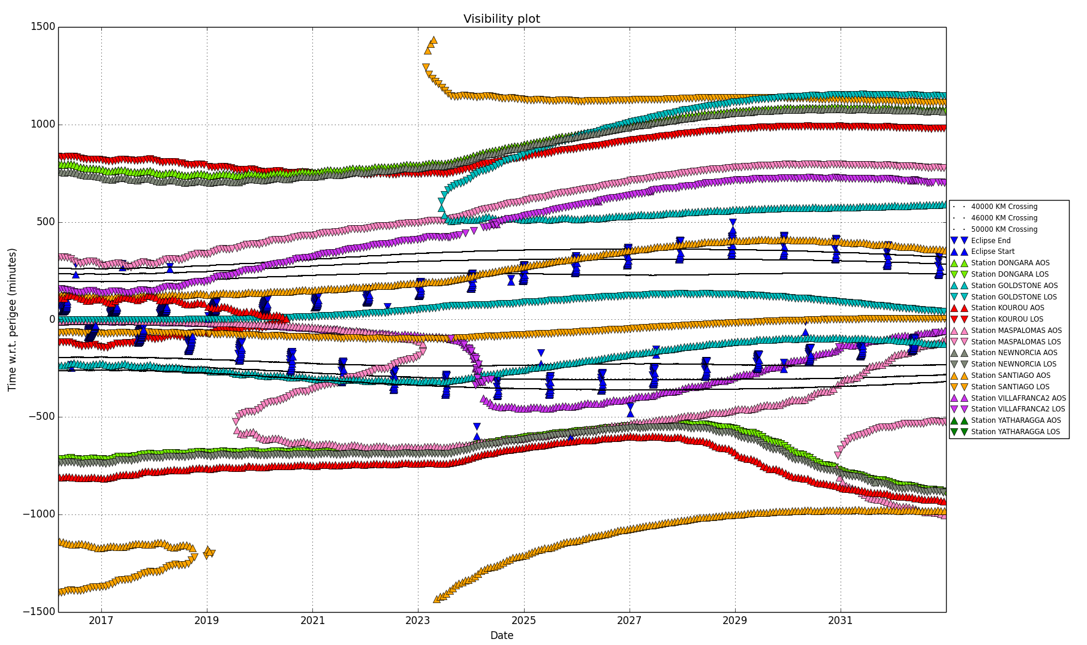
ground stations
Station | STATUS OF FREQUENCY LICENCE
Kourou | No expiration
Yatharagga | up to the service provider
Villafranca 2 & MSP | Service moved to INTA
New Norcia | Expires and is extended at the end of every year
Santiago | up to the service provider
Currently:
  Yatharagga and Kourou prime stations
  Backup: New Norcia, VilL2, MSP, Santiago
2017-2021:
  Perigee gap to be filled partially with MSP (INTA), VILII(INTA), DSN, new external service provider (?)
  Renewal of external station support
> 2021-
  Perigee gap will close

Slide 14
SPACON MERGER
Decision 2016 by OPS-O and SRE-O to merge the SPACON teams (Gaia, XMM-Newton, Integral)
  overall cost saving (Spacon team reduction from 9 to 6+1)
  reduction of Spacon workload, knowledge and training
  decrease in science performance on XMM-Newton, Integral accepted
Review of Requirements and Assumptions documents in December (New tools needed)
  Super Alarms tool => safe response to contingencies
  De-conflicting tool => shift planning of 1 SPACON for 3 missions
Kick off meeting for implementation took place 13/01/2017
Validation testing of S/W systems finished 03/2018
Readiness Review 13/03/2018 – GO! final meeting 10/04/2018
3 Mission Operations planned to start 11/04/2018

Slide 15
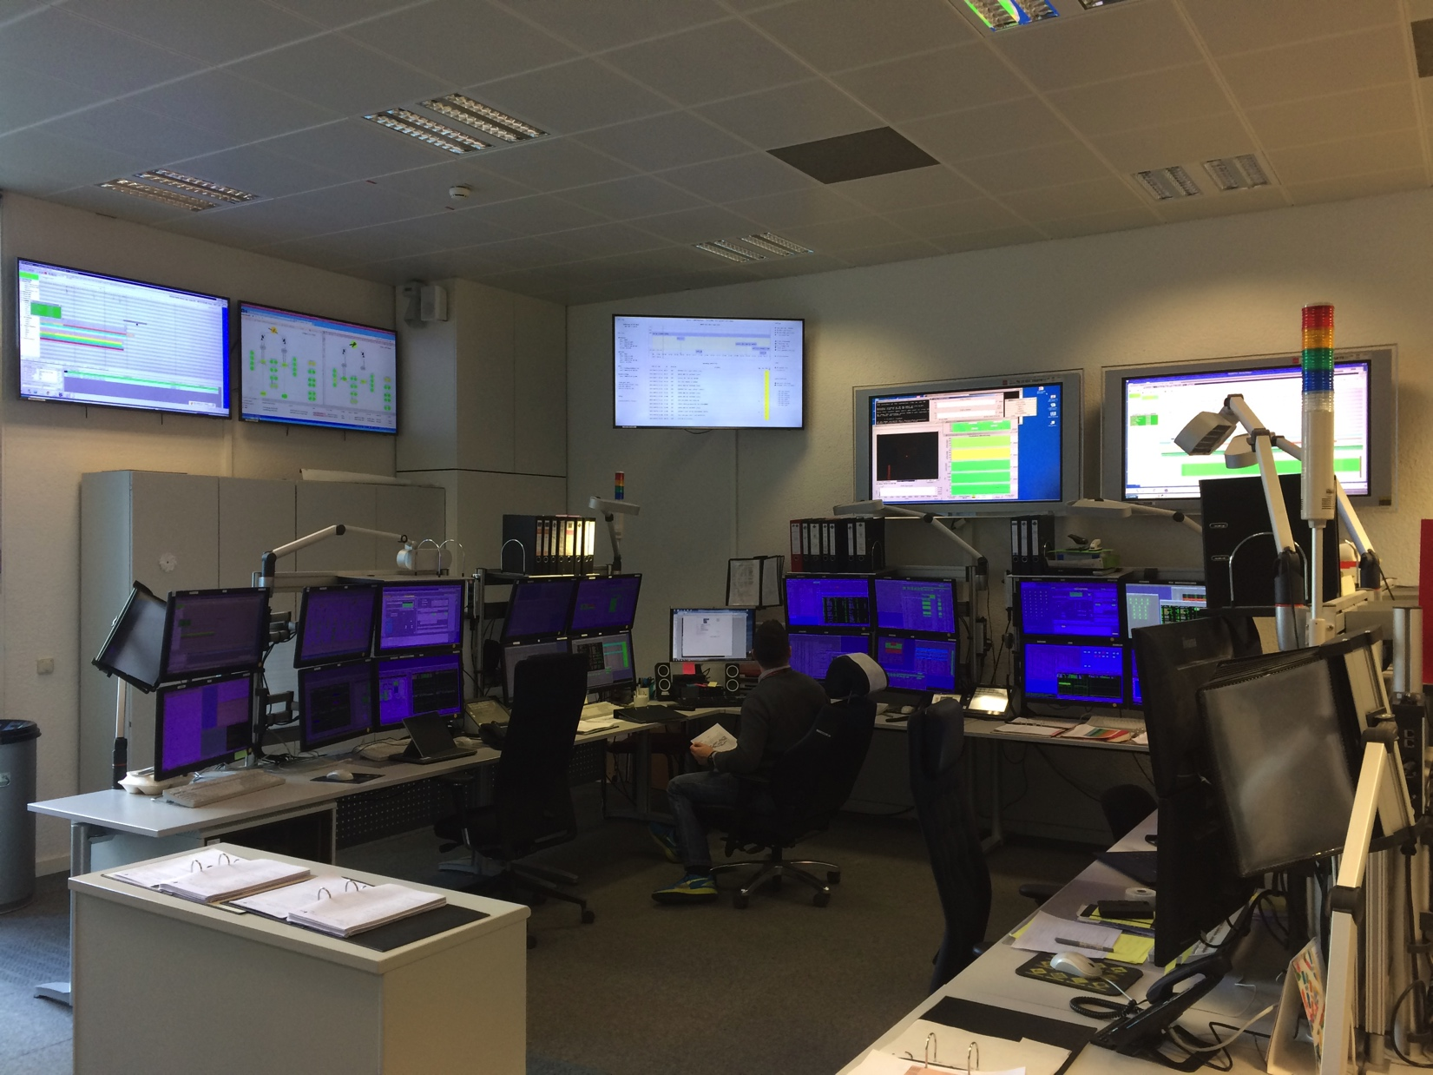
SPACON MERGER – Control Room
INTEGRAL
XMM
Gaia

